Slide 1
Deep Learning: Neural Network Introduction
By: Satyen S.

Slide 2
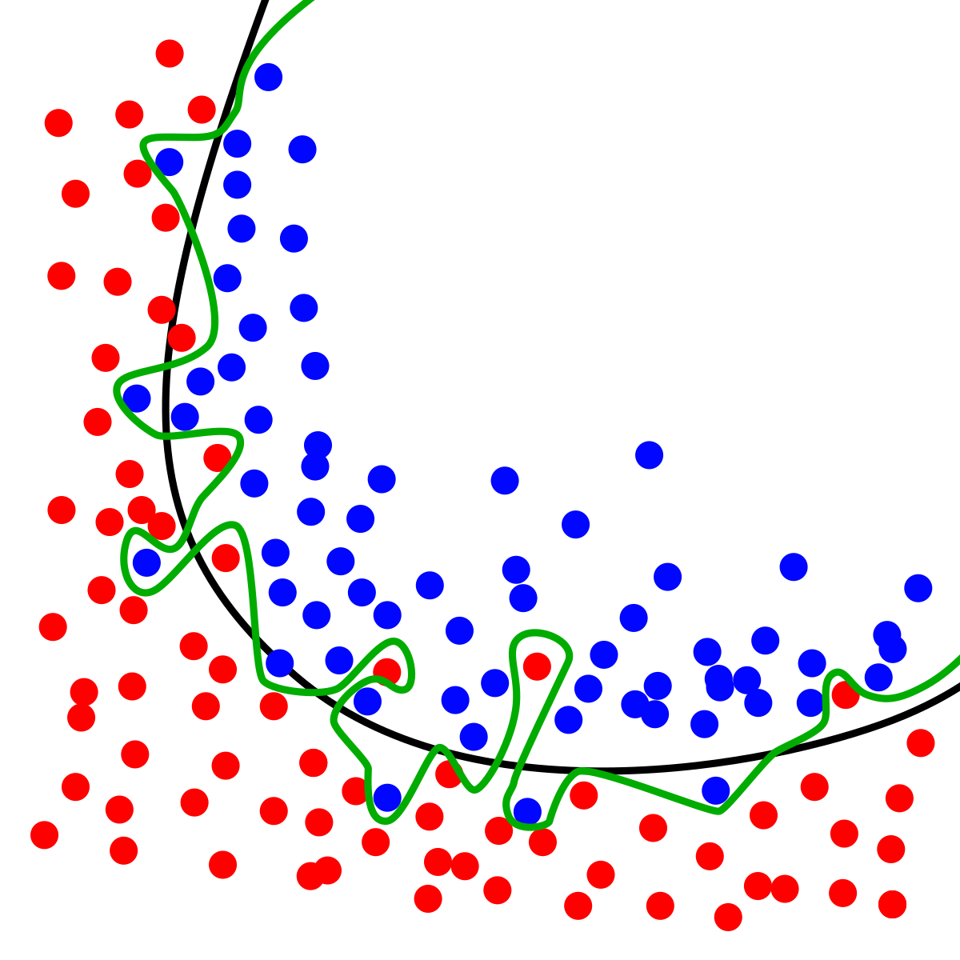
Recap: Model Training
Which of the following describes a danger associated with training models? Define the term.
Hyperparameter optimization
Multithreading
Overfitting
Dimensionality reduction

Slide 3
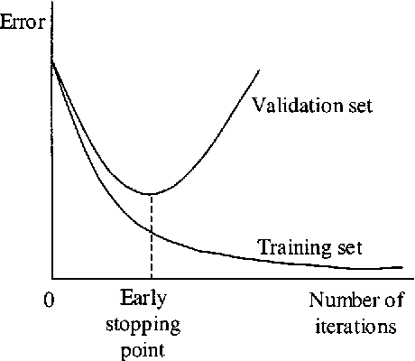
Combatting Overfitting: Strategies
Common Strategies (ML)
Dimensionality Reduction/Feature Selection
L1/L2 Regularization (SciKit Learn “C” hyperparameter)
Can use GridSearchCV() module
https://towardsdatascience.com/gridsearchcv-for-beginners-db48a90114ee
Dropout layers
Early stopping
https://towardsdatascience.com/8-simple-techniques-to-prevent-overfitting-4d443da2ef7d

Slide 4

Recap: Model Training
Which of the following is NOT an encouraged method of optimizing a model?
Use the testing data to train the model
Create multiple models and turn the aggregate of their predictions
Modifying hyperparameters
Data preprocessing and cleaning

Slide 5

Recap: Binary Classification
Which of the following models would be the best fit for predicting whether it would rain in the next hour based off of an image taken tonight?
Linear Regression
Polynomial Regression
Logarithmic Regression
Logistic Regression

Slide 6
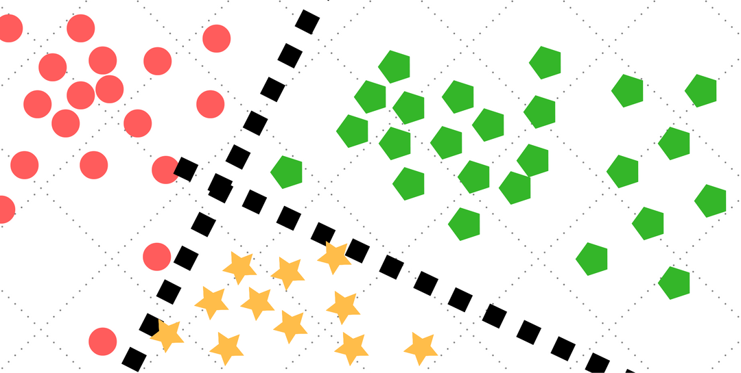
Recap: Classification Concepts
Which of the following can be used to evaluate a classification model?
Mean Squared Error
Confusion Matrix
Decision Tree
Absolute Squared Error

Slide 7
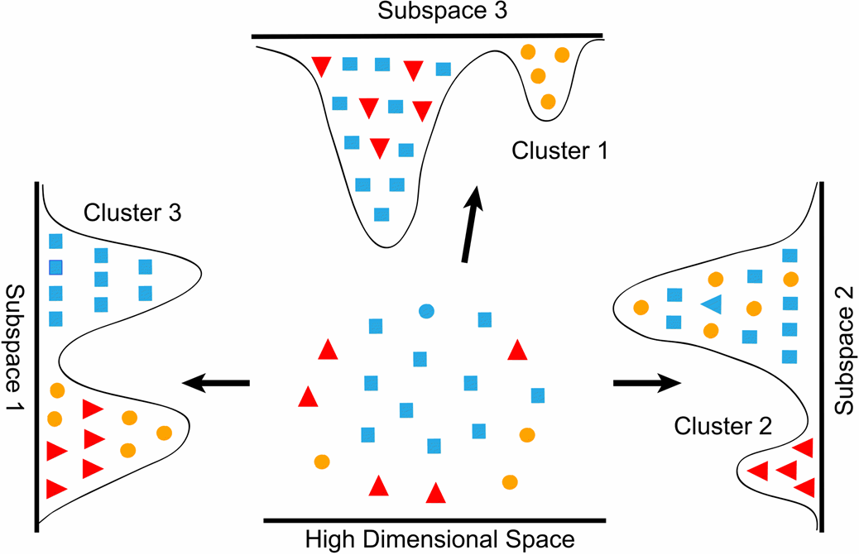
Recap: Dimensionality Reduction
Which of the following is NOT a reason to perform dimensionality reduction?
Enrich the features of data
Remove noise within the data
Combat overfitting caused by data
Reduce computation resources

Slide 8
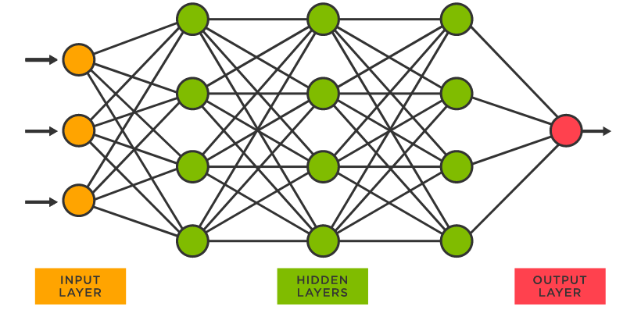
Neural Networks: Overview
Loosely modeled off of human brain
Composed of various “nodes”
Receive input
Return output
Three layers
Input
Hidden
Output
Fully Connected

Slide 9
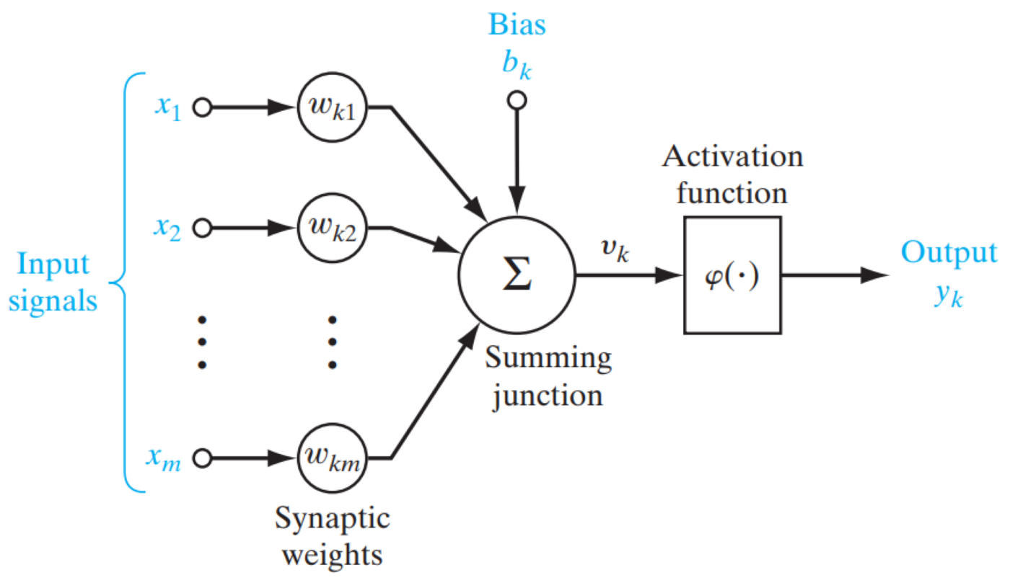
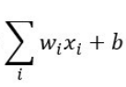
Neural Networks: Nodes/Perceptrons (Overview)
Represents a “Neuron”
Receive weights from ALL nodes in previous layer
Multiply each input by a weight and take the sum.
Add the bias (node specific)
Plug input into an “Activation Function”
Push output to the next node
NODE

Slide 10
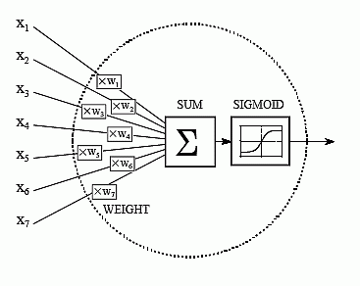
Neural Networks: Inputs
In fully connected NN, every nodes in earlier layer feeds into next layer
# of Nodes in first layer matches # of input columns
Each field in data is provided to a single node
Data should be scaled before plugging into model

Slide 11
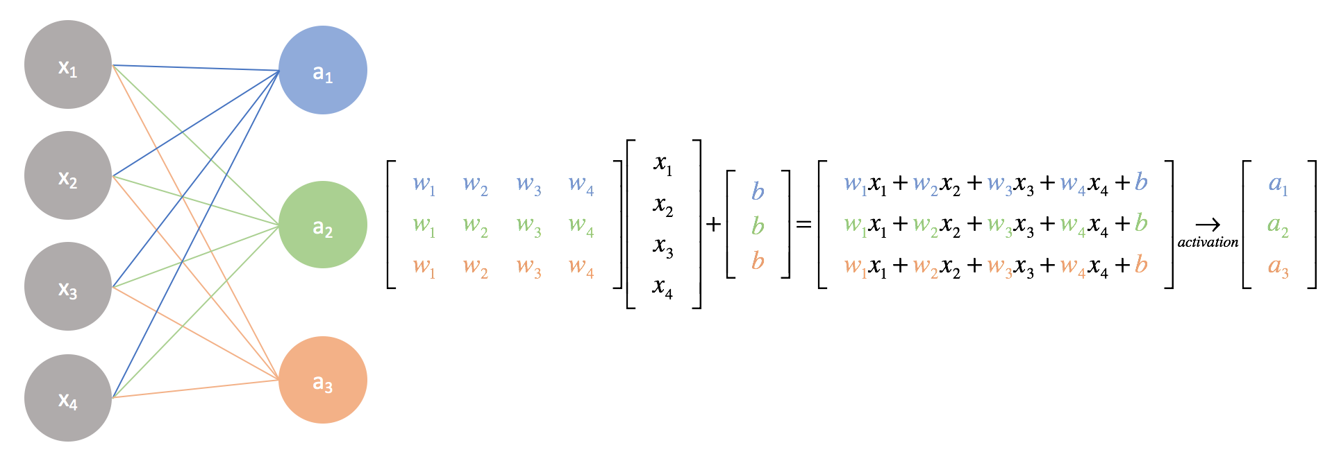
Neural Networks: Weights and Bias
Each node has DISTINCT weights for all input nodes
Represented as vector computationally for each layer

Slide 12

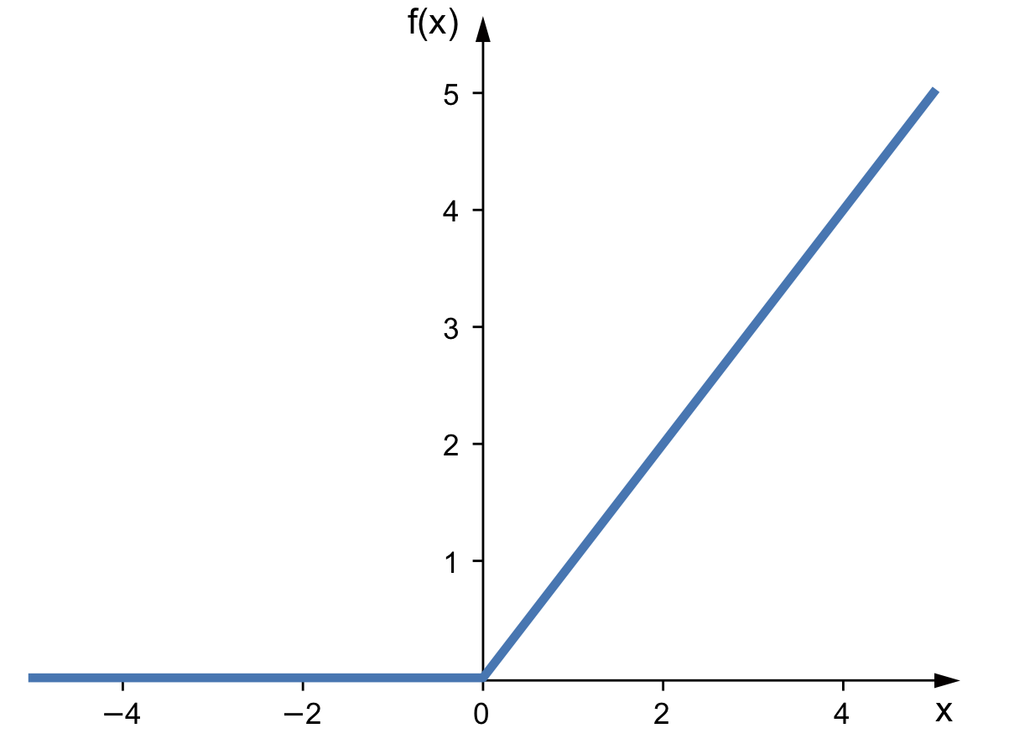
Neural Networks: Activation Function
Processed node inputs are plugged into activation function
Prevents Linearity of data, allows patterns to be recognized in data
Can allow for node output range to be restricted
Can allow for nodes to be turned off
More info: https://blog.goodaudience.com/most-intuitive-explanation-of-activation-functions-fdf6d9b4a53a

Slide 13

Neural Network: Popular Activation Functions

Slide 14
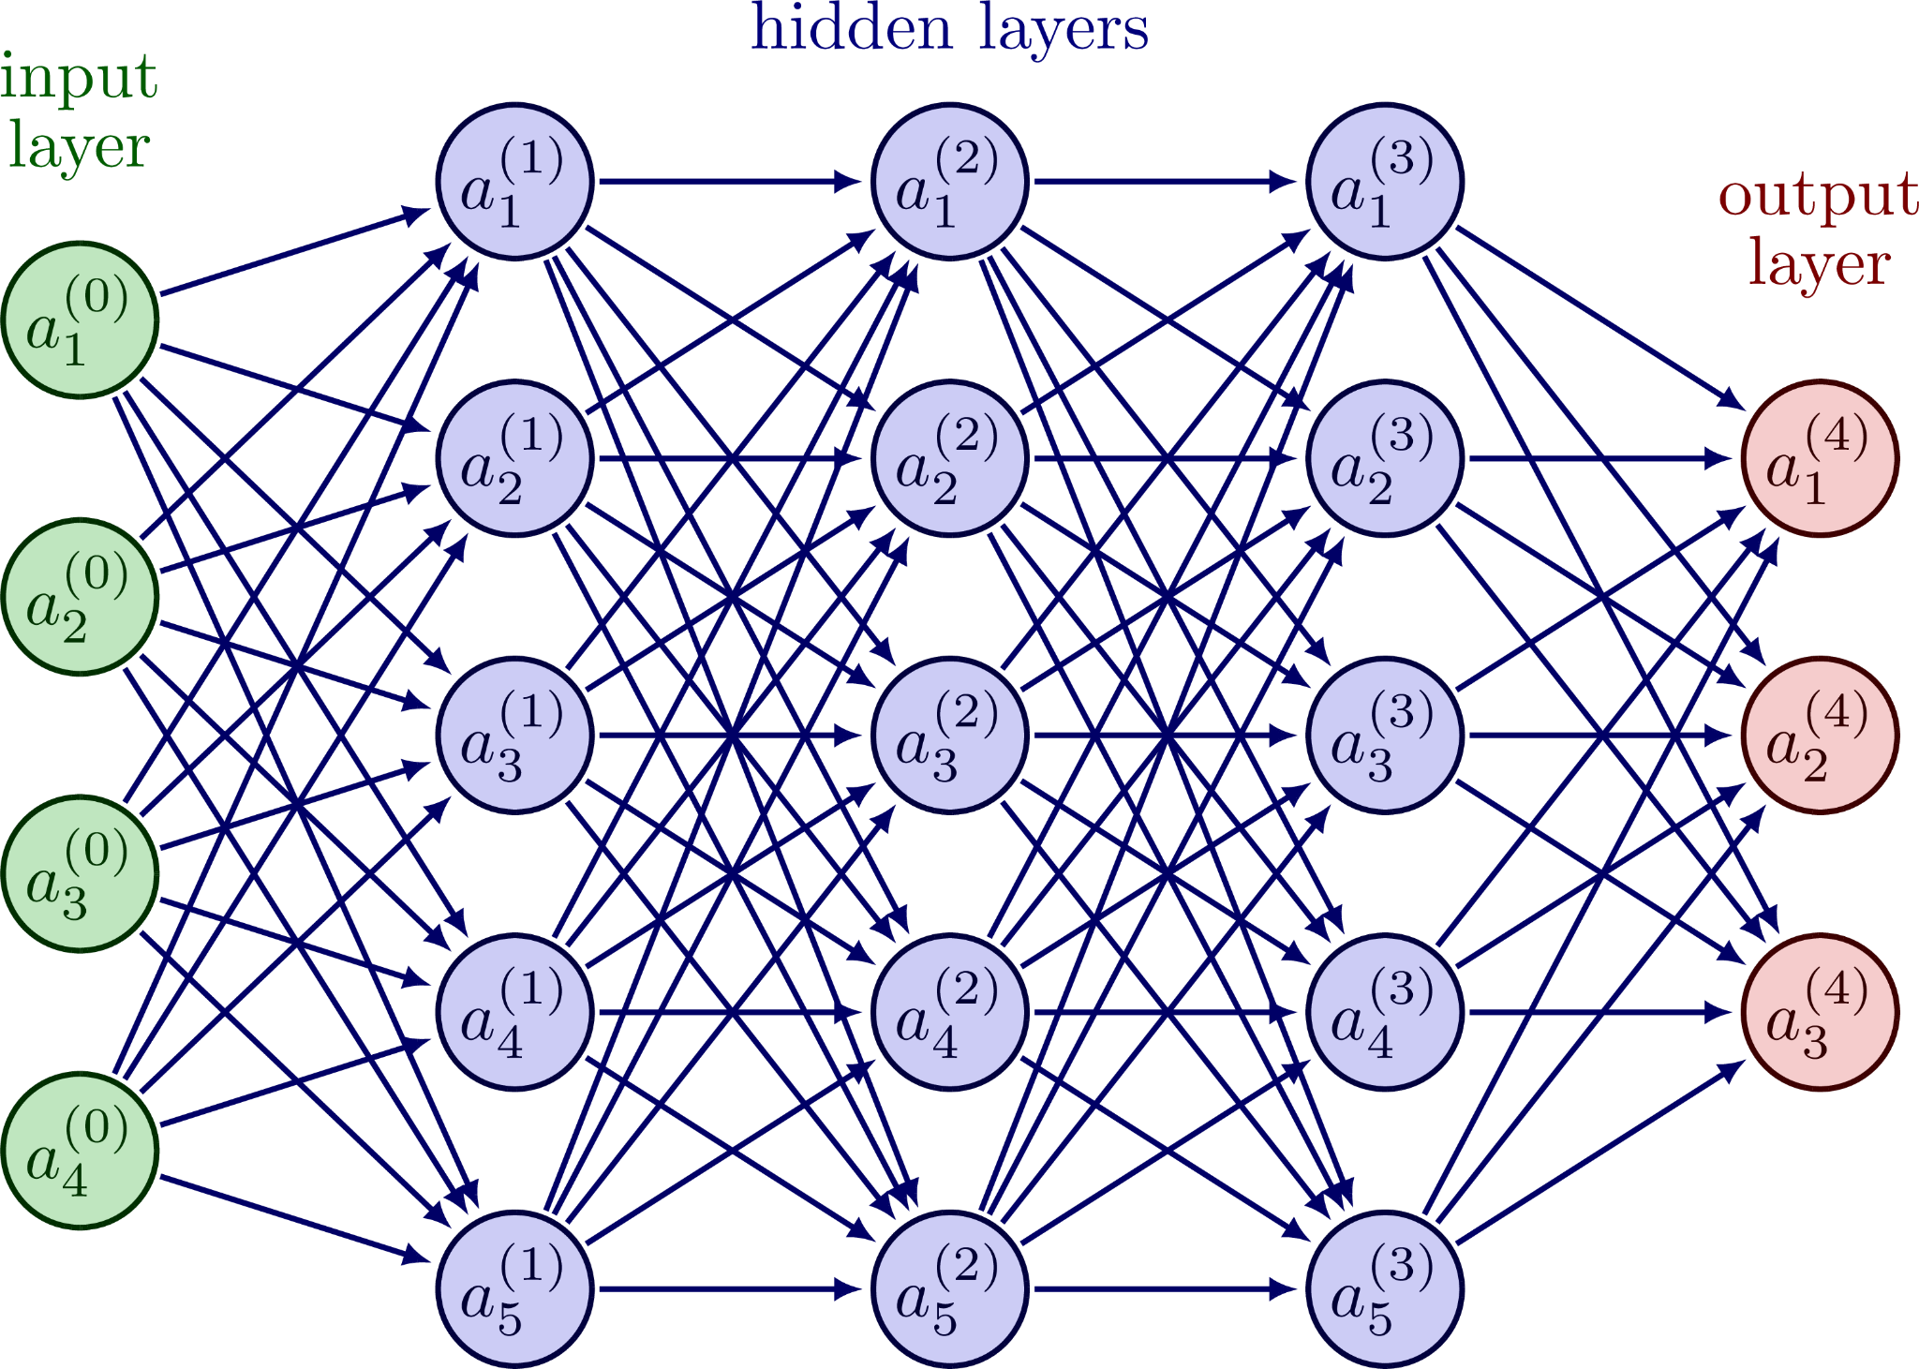
Neural Networks: Conceptual Summary
Comprised of nodes/perceptrons
Generally fully connected, feed forward
Can be used for regression, classification, etc.
Great for when you have LOTS of data
Optimization Techniques
Tune Hyperparameters (epochs, batch size, loss, activation function)
Modify Hidden Layer structure (# of layers, # of nodes per layer)

Slide 15
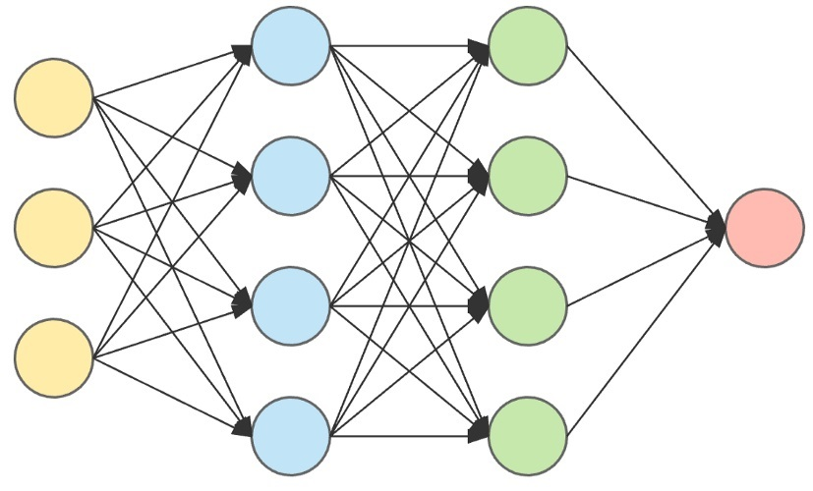
Creating Neural Networks: SciKit Learn Regression
SciKit Learn: Multi-Layer Regressor (MLP Regressor): https://scikit-learn.org/stable/modules/generated/sklearn.neural_network.MLPRegressor.html
# Input nodes = # of features
# Output nodes = 1
Essentially a managed neural network
Can specify size and shape of neural network with hidden_layer_sizes parameter

Slide 16
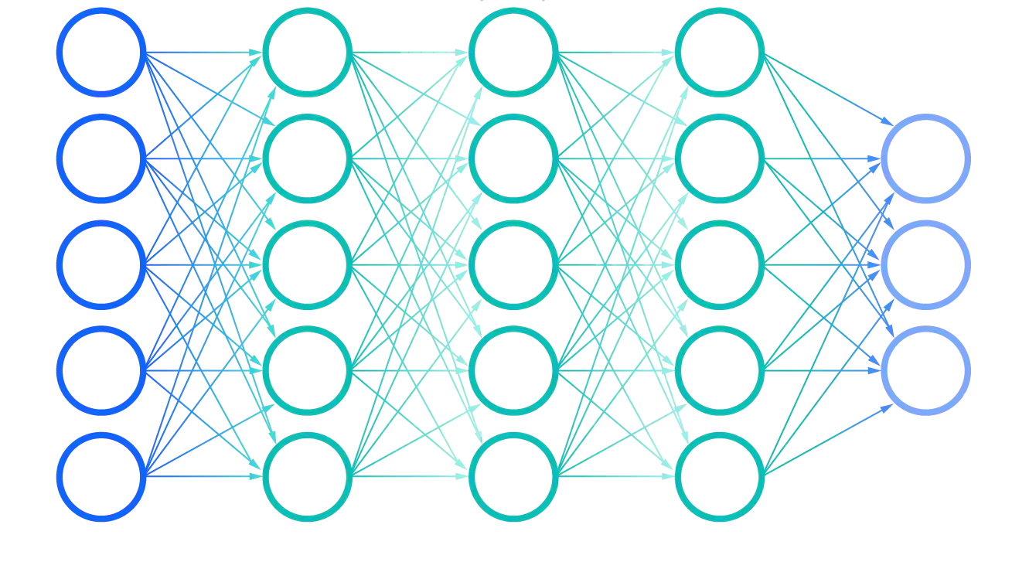
Neural Networks: SciKit Learn Classification
SciKit Learn: Multi-Layer Perceptron (MLP Classifier): https://scikit-learn.org/stable/modules/generated/sklearn.neural_network.MLPClassifier.html
# output nodes = # prediction classes
Prediction is output node with largest value

Slide 17
Neural Networks: Tensorflow (Keras)
Tensorflow in your browser: https://playground.tensorflow.org/
model = tf.keras.Sequential() represents a NN object
Define Model
Add layers to the network with model.add([LAYER DEFINITION])
Dense([Size]) represents a simple layer
Compile Model
Define optimizer and learning rate (we’ll talk about choosing this in the future)
Call model.compile(), specifying optimizer and loss metric
Fit Model
Same as SciKit Learn - plug in the training data
Can specify the batch size and # of epochs here (we’ll talk about this in the future
Evaluate Model and Make Predictions…
Additional reading: https://machinelearningmastery.com/tensorflow-tutorial-deep-learning-with-tf-keras/

Slide 18
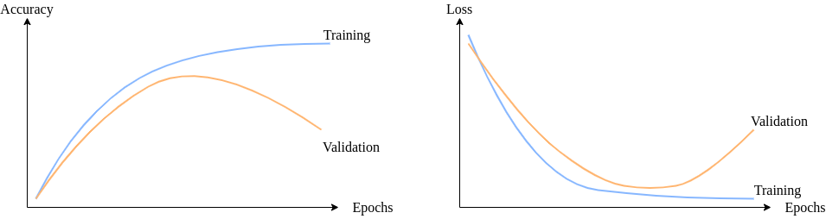
Hyperparameters: Epochs
Epoch = single run through of the ENTIRE training dataset with our model
Many epochs allow for better detection of patterns
Optimal epochs depends on model structure AND data
Run the risk of overfitting
Optimization: Train model with MANY epochs, graph accuracy/loss, determine optimal epochs

Slide 19
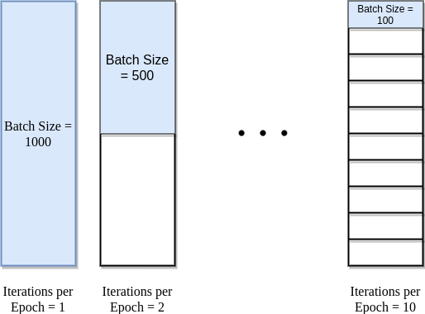
Hyperparameters: Batch Size
Batch size is the # of data rows plugged into the model BEFORE the weights are adjusted
Iterations is the number of batches per epoch
Test data size should be a multiple of the batch size

Slide 20
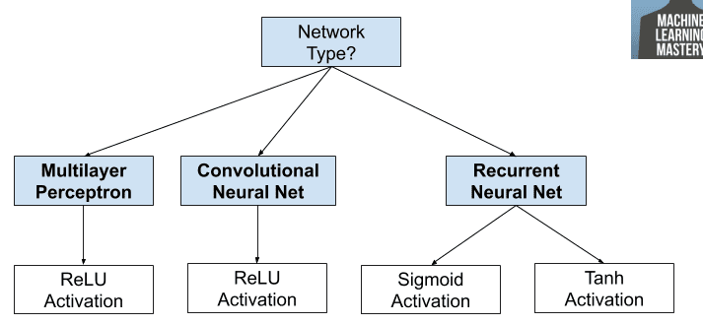
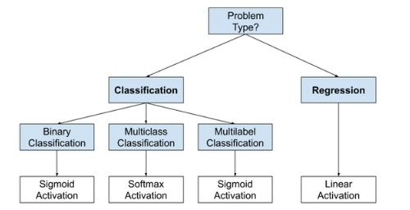
Hyperparameters: Activation Functions
Generally apply activation function at each layer of the Neural Network
Activation functions generally follow the following structure ------------------>
MLP ~ Regression
CNN ~ Classification
RNN ~ Timeseries, NLP, etc.
https://machinelearningmastery.com/choose-an-activation-function-for-deep-learning/

Slide 21
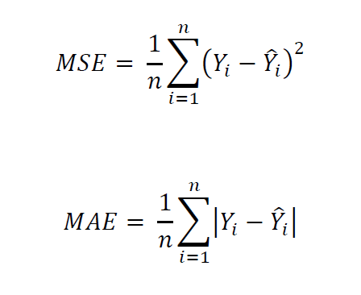
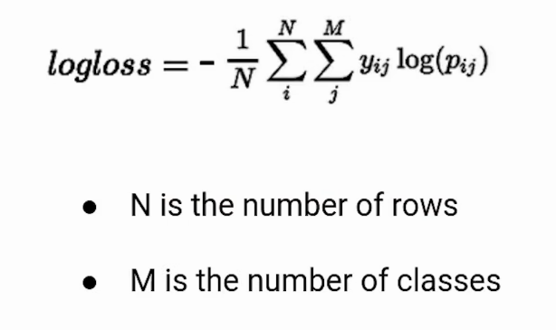
Hyperparameters: Loss/Cost Functions
Determines what the model will be measuring
Regression (see WK3) : Mean Squared Error (MSE), Mean Absolute Error (MAE)
Classification: Cross Entropy Loss, Divergence Loss, etc.
More options: https://machinelearningmastery.com/how-to-choose-loss-functions-when-training-deep-learning-neural-networks/

Slide 22

Hyperparameters: Learning Rate
Determines how fast the weights of the model should change
Generally set at 0.01 or 0.001
Can be dynamic (decrease over the course of training)
Works with optimizer (which actually adjusts weights)

Slide 23


Hyperparameters: Optimizers
Determines which weights to modify and how to do so
Modifies model based on each batch, aiming to minimize the Loss Function
Popular Optimizers: Stochastic Gradient Descent (SGD), Adam, Adadelta, Adagrad, etc.
More info: https://www.analyticsvidhya.com/blog/2021/10/a-comprehensive-guide-on-deep-learning-optimizers/#:~:text=An%20optimizer%20is%20a%20function,loss%20and%20improve%20the%20accuracy.

Slide 24
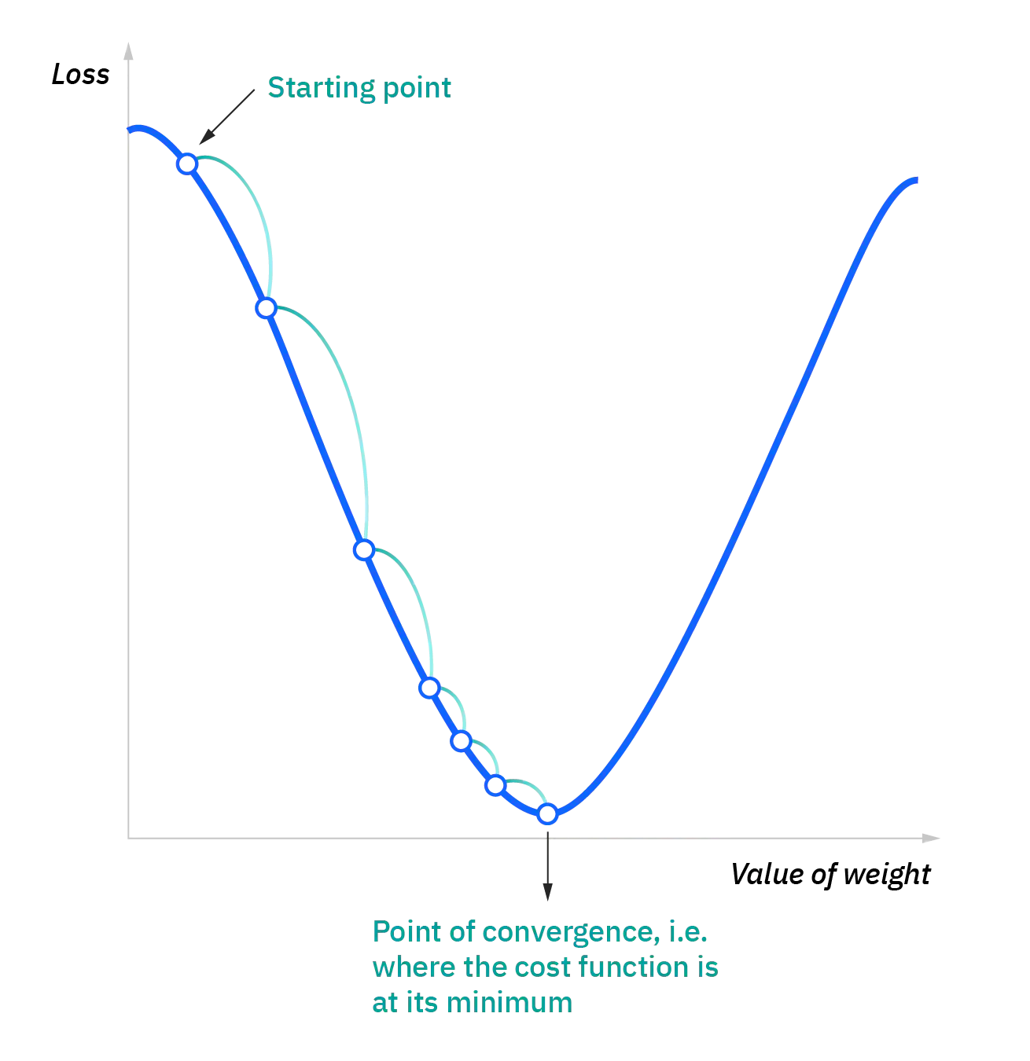
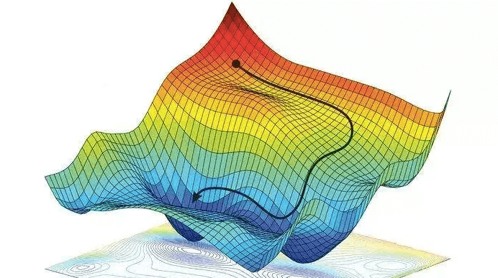
Hyperparameters: Optimizers - SGD
Iterative algorithm
Plug in some data and calculate the error (using loss function)
Calculate the derivative/gradient of the error function
Scale the gradient by the learning rate
Move in the direction opposite the gradient (to move to the minimum of the loss function)
SGD is generally reliable, but can be slower than other optimization techniques

Slide 25
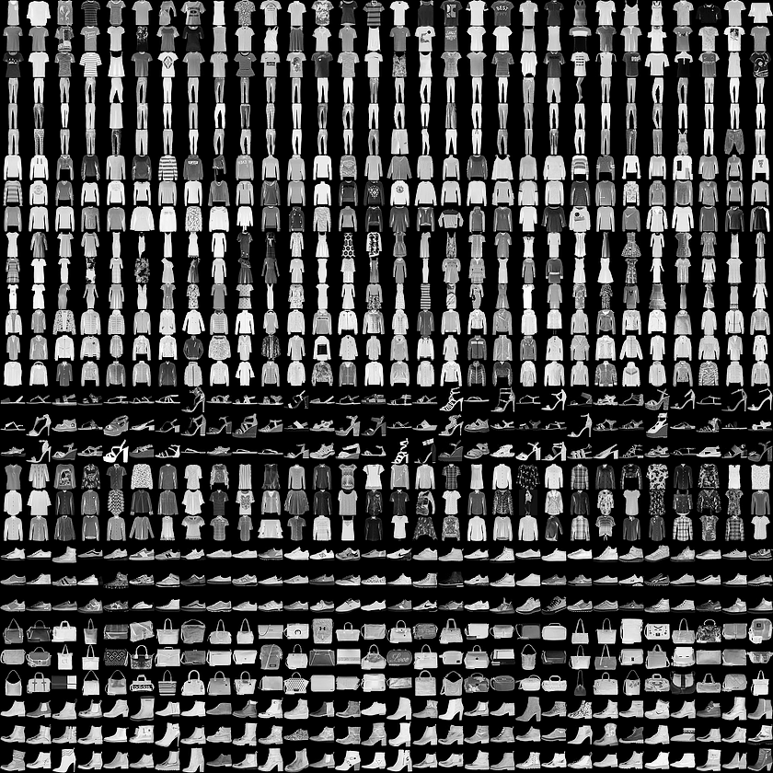
Looking Forward: Neural Networks Optimization
Specialized layer types (CNN, RNN, etc.)
Classifying Images of clothing
Determine how to structure model
In practice choosing: activation functions, loss metrics, optimizers, epochs, batch sizes, etc.
https://colab.research.google.com/drive/18T0K_jVJkVfUQiaUKn0U7uGxUCqiLOGs?usp=sharing
Notes:
Neural Networks: for next time

